Slide 1

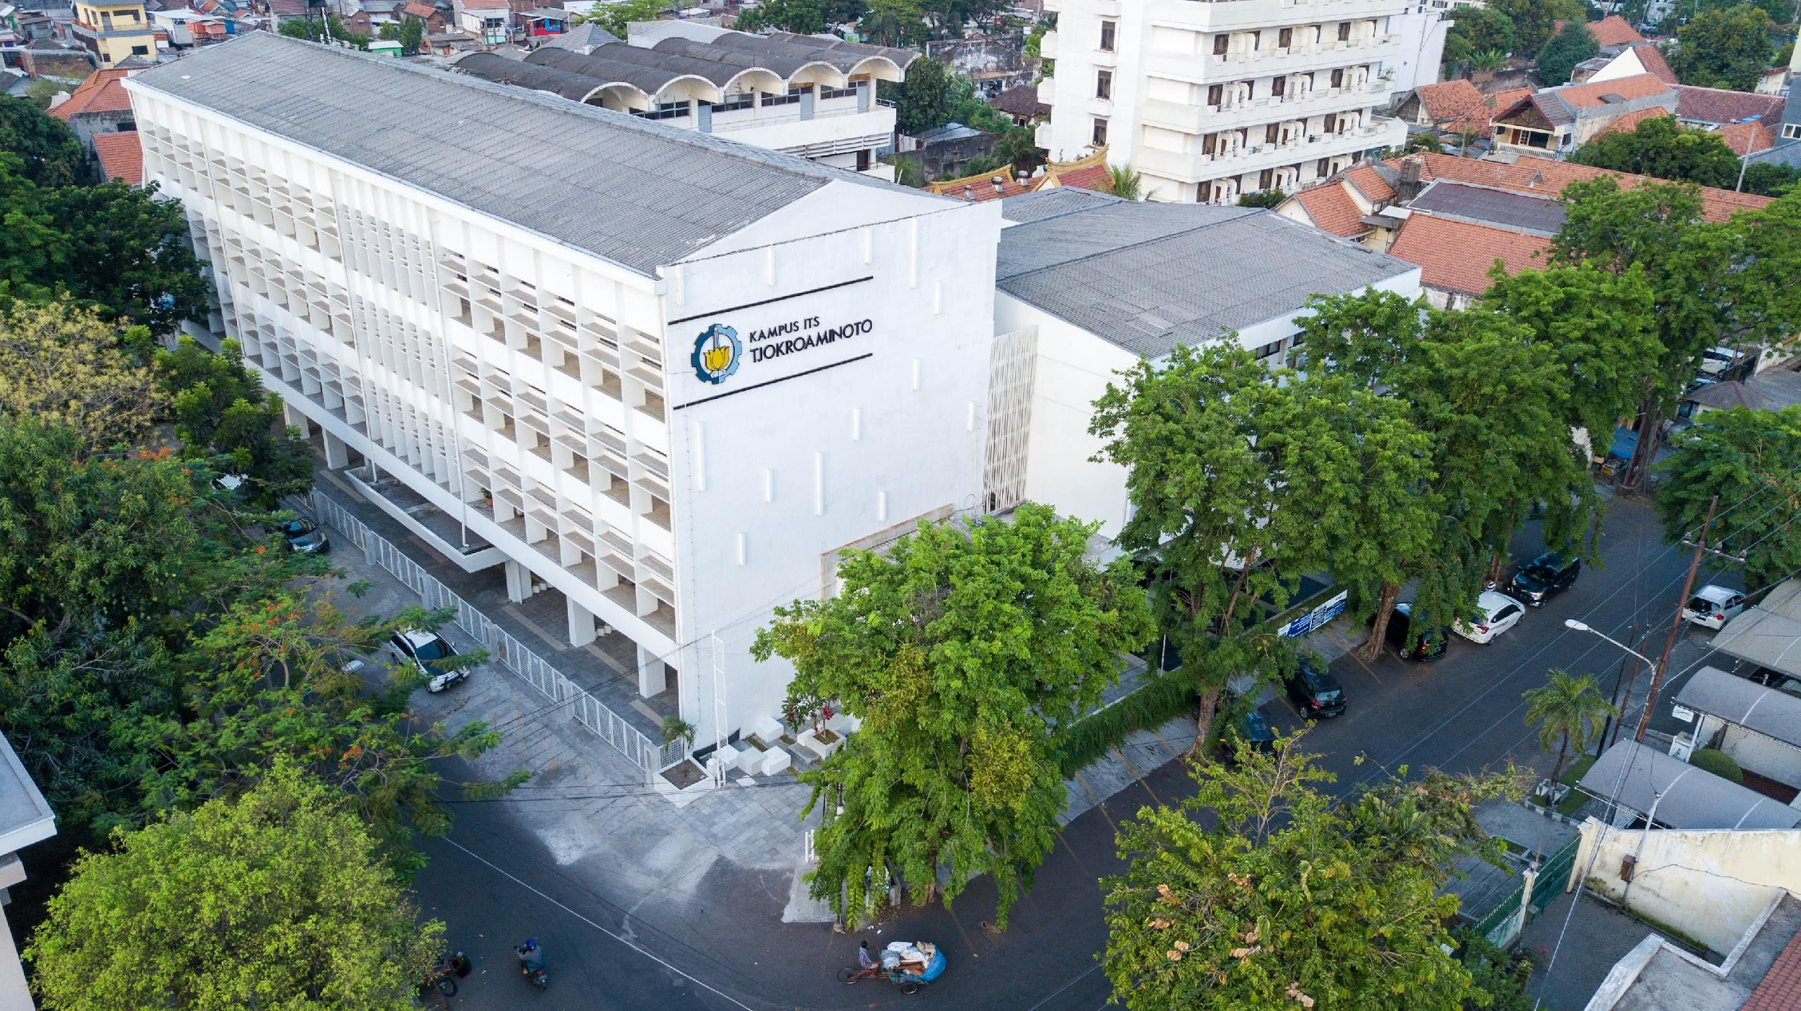



10
THE 10TH INTERNATIONAL CONFERENCE ON MANAGEMENT OF
TECHNOLOGY, INNOVATION AND PROJECT
Universitas Brawijaya
Imam Cholissodin
“Development of an Optimization Campus Management Framework Using Meta-Deep AI Based on Nine Helix Model and Open Innovation”
Imam Cholissodin^{1*}, Taufiq Choirul Amri², Sherly Ardhya Garini³, Arief Andy Soebroto¹
¹ Department of Informatics Engineering, Universitas Brawijaya, Malang, Indonesia
²Department of Informatics, Institut Teknologi Sepuluh Nopember, Surabaya, Indonesia
³Department of Informatics, Institut Teknologi Sepuluh Nopember, Surabaya, Indonesia
⁴Department of Informatics Engineering, Universitas Brawijaya, Malang, Indonesia
*Corresponding author: imamcs@ub.ac.id
Tjokroaminoto ITS Campus
Cokroaminoto Street 12A, Surabaya 60264
Tel: +62315613922, +62315666172 | E-mail: info@mmt.its.ac.id

Slide 2
INTRODUCTION
Limited time, energy in the workplace and the need to divide time for other activities, such as community, family, etc. based on "load balancing”.
Decreasing physical ability over time working if only relying on body strength for the sustainability of work productivity, need optimization of smart work, not just hard work.
Lack of elasticity and flexibility of timeline scheduling.
The automation administrative task process to produce ready-to-use reports is not yet optimal.
Lack of workload balancing, so that sometimes there is work overload.
Lack of development of a meta-deep ai-based system to reduce work or project time as a time profit (time saving) for various adaptive management variations, so that the body is not forced as an effort to maintain health

Slide 3
LITERATURE REVIEW
Campus Management Framework
The Campus Management Framework utilizes various technological solutions to improve the efficiency and effectiveness of almost all activities.
Management often plays a dominant role because it unites Information Technology (IT) and organizational strategies to achieve common objectives through collaboration and strategic system integration.
Previous Helix Model and Open Innovation
The Helix Model is a framework that outlines the interactions of mutually beneficial activities among key actors (n-Helix) within entity's ecosystem.
Open Innovation is a management approach that promotes organizations to embrace external ideas and technologies, share knowledge, and collaborate on innovation outcomes with others to accelerate the innovation process.
Meta-Deep AI Algorithm (AI, ML, Deep Learning, Meta-Learning & LLM)
Performance Measure (BSC, and others)

Slide 4
METHODS
We propose the integration of all Meta-Deep AI, accompanied by the adoption of several performance evaluation formulas such as the balanced scorecard, among others.
This integration is summarized and named the Meta-Quantum Unified Balanced Intelligence for Time-based Sustainability (meta-QUBITS1) Framework, version 1.
Meta-QUBITS1, or the short label QUBITS1, supports the adaptive concept as it can collaborate with existing approaches while maintaining its own indicators as a unique feature as tools for Development of an Optimization Campus Management Framework.
“Meta-QUBITS Framework”

Slide 5
METHODS
Steps for Implementing
Determining of Weight
Data Collection
Metric Calculation
Evaluation, Validation, and Reporting
“Meta-QUBITS Framework”
No | m Sample Case "Meta-Deep AI" Apps i-th as a Services | With or Without the Union of the Helix Model (H₁-H₉) Based on Direct and Indirect Activities |  | Helix Weights (WH_{j}) | With or Without the Union of Open Innovation (O₁-O₅) Based on Direct and Indirect Achievement Results (Before - After, Target - Actual) |  | Open Inn. Weights (WO_{r})
 |  | n₁ Key Points as Indicators of (H_{ij} ∩ F_{ikq})' | n₂ Key Points as Indicators of (H_{ij} ∩ F_{ikq}) |  | n₃ Key Points as Indicators of (O_{ir} ∩ F_{ikq})' | n₄ Key Points as Indicators of (O_{ir} ∩ F_{ikq})
1 | Smart Data AI Studio | 94, 96, .., 78 |  | 0.19, 0.18, .., 0.08 | 89, 82, .., 83 |  | 0.23, 0.16, .., 0.21
2 | Academic Document Review | 93, 82, .., 93 |  | .. | .. |  | ..
.. | .. | .. |  | .. | .. |  | ..
m | .. | .. |  | .. | .. |  | ..
FIGURE 1. The Nine Helix Model Visualization with Religion as Foundation in Green, Where In Indonesia, The Ministry of Religious Affairs (Kementerian Agama RI) Could Serve as an Essential Component.
Format Dataset

Slide 6
RESULTS (1 of 3)
The results of implementing the QUBITS1 Framework focus on self-assessment
FIGURE 3. Key Points Visualization of All Apps based on Weights

Slide 7
RESULTS (2 of 3)
Which does not directly evaluate the strengths and weaknesses of campus management but instead emphasizes providing solutions for recommending the optimal weights for WH_{j} and WO_{r} through stigmergy with offers numerous potential solutions for global optimization, e.g. utilize Particle Swarm Optimization (PSO) Algorithm.
It provides multiple options for developing campus management according to the capabilities of each campus in the future. This means these options can be reconsidered by stakeholders to choose the best one, considering the specific characteristics of each campus.
FIGURE 4. Convergence of Maximum Fitness Value

Slide 8
RESULTS (2 of 3)
In the Apps column, for example, existing apps with supervision and ethics at the institution include (11 Apps as sample case):
Smart Data AI Studio
Academic Document Review
Scientific Document Generator
Study Timeline Optimization
Human Resource Load Balancing
Project Management
Tridharma Management
Accreditation Management
Equitable Distribution of Research and Service Funding
Student Competition Preparation Optimization
HR Character-Building
In the Figure 5, an estimated area is included, filled with green color.
FIGURE 5. 2D Visualization with Synthetic Theta and Smooth Spiral (Polar)

Slide 9
CONCLUSIONS
The QUBITS1 Framework has been successfully implemented as a self-assessment tool, utilizing a simulated dataset ( source: https://github.com/imamcs19/meta-QUBITS-Framework ) with an adaptive mechanism designed to ease its use.
The process begins with data collection, followed by computation using Meta-Heuristic algorithms to obtain the optimal WH_{j} and WO_{r} values and others, achieving a Fitness Score of 81.01 (Good), and demonstrates that the framework is highly suitable for independently measuring the performance of campus management.
In future research, the QUBITS2 Framework can be developed to be more holistic, by testing it on real datasets, supporting not only self-assessment.
Additionally, more "Group Factors 1, 2, ..., p" can be added to enrich the evaluation process envolved an adaptive n-Helix Model.

Slide 10

10
THANK YOU
THE 10TH INTERNATIONAL CONFERENCE ON MANAGEMENT OF TECHNOLOGY, INNOVATION AND PROJECT
"By integrating Meta-Deep AI-based Helix Model and Open Innovation, the Meta-QUBITS Framework is Propose to Unlock the Efficient, Adaptive, and Time-based Sustainable Potential of Campus Management by Optimization Technology”
Imam Cholissodin
Universitas Brawijaya

